Slide 1
Exercise - Learning Objectives
By the end of this exercise you will be able to:
Create a new model in OSeMOSYS
Define time slices
Define fuels
Define energy demands for a specific fuel
Define the temporal profile of energy demands
Define a simple technology that satisfies the demand
Run the model and check results on production by technology

Slide 2
Defining energy demands in OSeMOSYS
In OSeMOSYS, the final demand is characterized by these parameters:
YearSplit: defines the duration of a modelled time slice expressed as a fraction of the year; the sum of each entry over one modelled year should be equal to 1.
SpecifiedDemandProfile: defines the share of energy demand required in each particular time slice.
SpecifiedAnnualDemand [PJ]: defines the total specified demand for each modelled year, linked to a specific ‘time of use’ during the year.
AccumulatedAnnualDemand [PJ]: defines the total accumulated demand of a commodity that is constant along the year, for each modelled year.
NB: Same commodity demand cannot be defined by both Accumulated and Specified AnnualDemand.

Slide 3
Demand for future connections
Natural Gas
Electricity
Demand for electrified population
Natural Gas Production
Hydro run-of-river
Transmission & Distribution
Hydro Dam
Grid Expansion
Natural Gas Imports
Wind
Dist. Solar PV
New CCGT/GT
Dist. Solar PV with battery
Backstop 1
Backstop 2

Slide 4
Demand for future connections
Natural Gas
Electricity
Demand for electrified population
Natural Gas Production
Hydro run-of-river
Transmission & Distribution
Hydro Dam
Grid Expansion
Natural Gas Imports
Wind
Dist. Solar PV
New CCGT/GT
Dist. Solar PV with battery
Backstop 1
Backstop 2

Slide 5
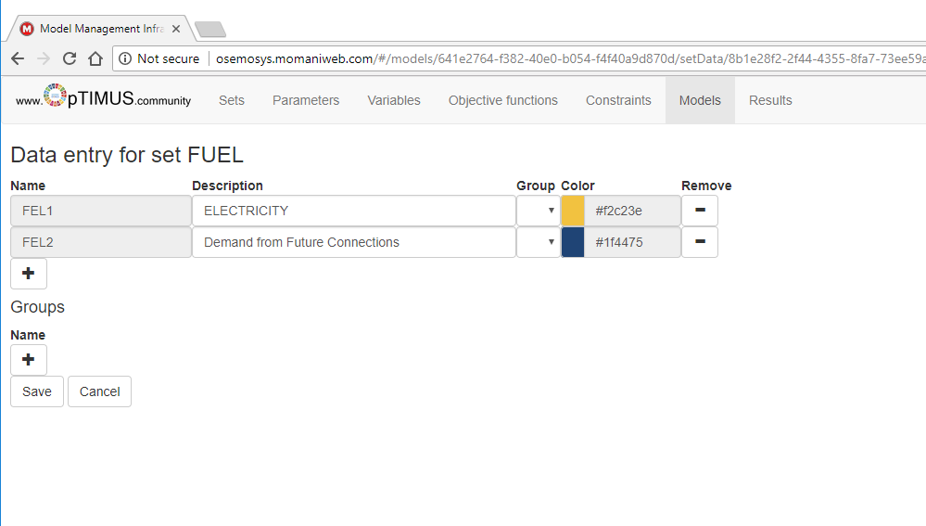
Defining electricity demand in households
Then, we need to create fuels (Set FUEL) to represent final consumption of electricity (let’s call these FEL1 for electricity for already grid connected households and FEL2 for demand from future connections)
Don’t forget to click ’Save’!!

Slide 6
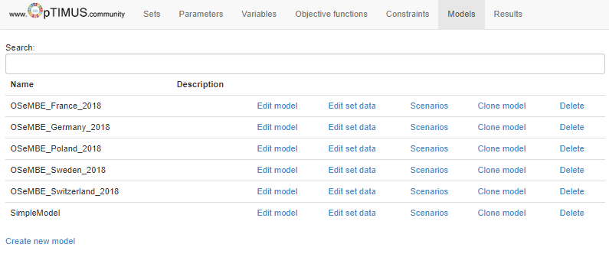
Defining electricity demand in households
Now click ’Back to model list’
In the model list, select ’Scenarios’ of your model
Here click on ’Enter data’

Slide 7
Choosing a demand type
Two options for demand
SpecifiedAnnualDemand - used for fuels whose demand varies within the year/day. E.g. electricity
AccumulatedAnnualDemand – used for fuels that do not necessarily have to be provided at an exact point in time. E.g. gasoline

Slide 8
Defining annual electricity demand
Since electricity demand varies within seasons and days, the parameter SpecifiedAnnualDemand has to be used for residential electricity. Insert the following values for the annual final electricity demand for the fuel FEL1
 | 2014 | 2015 | 2016 | 2017 | 2018 | 2019 | 2020 | 2021 | 2022
PJ | 2.214 | 2.225 | 2.274 | 2.342 | 2.426 | 2.509 | 2.589 | 2.683 | 2.78
 | 2023 | 2024 | 2025 | 2026 | 2027 | 2028 | 2029 | 2030 | 2031
PJ | 2.886 | 2.955 | 3.006 | 3.061 | 3.121 | 3.186 | 3.258 | 3.336 | 3.419
 | 2032 | 2033 | 2034 | 2035 | 2036 | 2037 | 2038 | 2039 | 2040
PJ | 3.503 | 3.589 | 3.676 | 3.763 | 3.855 | 3.952 | 4.054 | 4.161 | 4.273

Slide 9
Defining annual electricity demand
We proceed to enter annual final electricity demand projections (parameter SpecifiedAnnualDemand) for the fuel FEL2, which represents electricity consumption by newly electrified population.
 | 2014 | 2015 | 2016 | 2017 | 2018 | 2019 | 2020 | 2021 | 2022
PJ | 0 | 0 | 0 | 0 | 0.3 | 0.4 | 0.5 | 0.7 | 0.75
 | 2023 | 2024 | 2025 | 2026 | 2027 | 2028 | 2029 | 2030 | 2031
PJ | 0.9 | 0.95 | 1 | 1.1 | 1.2 | 1.25 | 1.28 | 1.3 | 1.35
 | 2032 | 2033 | 2034 | 2035 | 2036 | 2037 | 2038 | 2039 | 2040
PJ | 1.5 | 1.55 | 1.6 | 1.64 | 1.7 | 1.78 | 1.85 | 1.92 | 2.05

Slide 10
Demand variability - Seasonal

Slide 11
Demand variability - Seasonal
Demand corresponding to Summer

Slide 12
Demand variability - Daily
Demand corresponding to Summer Day

Slide 13
Defining duration of time slices
To calculate the values defining the duration of the time slices, we simply account for the length of each time slice within a year. For instance, if summer last 3 months (i.e. 25% of the year) and the night lasts 8 hours during summer (i.e. 33% of a summer day), summer nights account for 8.33% of the year (i.e. 33%*25%).
For our simple model case, insert the following values for the parameter YearSplit:
ID | 0.1667
IN | 0.0833
SD | 0.1667
SN | 0.0833
WD | 0.3333
WN | 0.1667

Slide 14
Defining load profile
In the case of our simple model, we will define three seasons (Summer, Winter and Intermediate), each one split into two day parts (Day and Night).
When using the parameter SpecifiedAnnualDemand to define how much energy demand is required annually for a specific fuel, the SpecifiedDemandProfile also needs to be defined.
  SpecifiedDemandProfile defines the share of energy demand required at each particular part of the year (i.e. timeslice).
    E.g. 15% of the electricity demand in households corresponds to the Summer Day (SD) timeslice

Slide 15
Defining load profile
To calculate the required values for SpecifiedDemandProfile, we multiply the share of demand of the season in question (e.g. summer – 20%) by the share of demand of the day part within that season (e.g. day – 75%) to arrive at a final value for summer day (e.g. 15%)
For our simple model case, insert the following values for SpecifiedDemandProfile of fuels FEL1 and FEL2 for all years:
ID | 0.12
IN | 0.08
SD | 0.15
SN | 0.05
WD | 0.4
WN | 0.2
Don’t forget to click ’Save’!

Slide 16
Adding a backstop technology I
Then, we have to define relevant parameters for the TECHNOLOGY called Backstop1, whose purpose is to indicate the level of unserved electricity demand.
Let’s input the following data for the entire period
Parameter | Mode of Operation | Fuel | 2014-2040
VariableCost | 1 | -- | 999999
CapitalCost | -- | -- | 999999
OutputActivityRatio | 1 | FEL1 | 1
OperationalLife | -- | -- | 1

Slide 17
Adding a backstop technology II
Then, we have to define relevant parameters for the TECHNOLOGY called Backstop2, whose purpose is to indicate the level of unserved electricity demand.
Let’s input the following data for the entire period
Parameter | Mode of Operation | Fuel | 2014-2040
VariableCost | 1 | -- | 999999
CapitalCost | -- | -- | 999999
OutputActivityRatio | 1 | FEL2 | 1
OperationalLife | -- | -- | 1

Slide 18
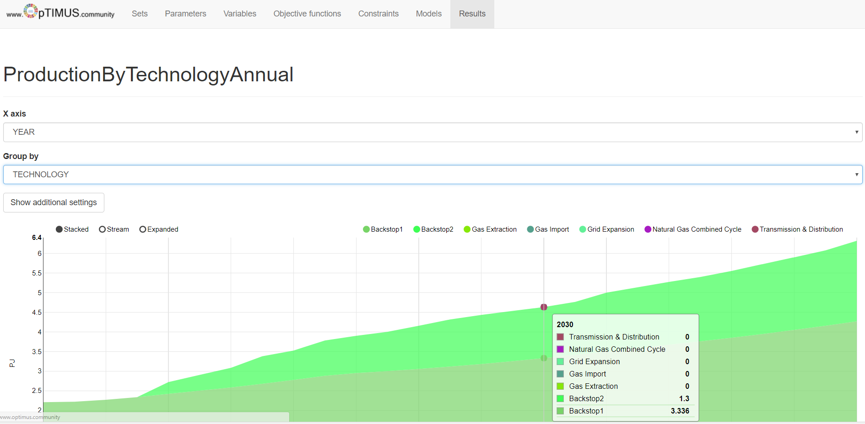
Run the model and check the results!
Notes:
In case of issues in this step check the values for:
AvailabilityFactor
CapacityFactor
CapacityToActivityUnit
DepreciationMethod
DiscountRate
ReserveMargin
TotalAnnualMaxCapacity
TotalAnnualMaxCapacityInvestment
TotalTechnologyAnnualActivityUpperLimit
TotalTechnologyModelPeriodActivityUpperLimit
In the latest version of MoManI the default values should be reasonable, but…

